Slide 1
PHP - Strings
String are noted by either single quotes ‘ ’ or double quotes “ ”.
Singly quoted strings are treated almost literally, whereas doubly quoted strings replace variables with their values as well as specially interpreting certain character sequences.

Slide 2
PHP - Strings
<?php
$variable = "name";
$literally = 'My $variable will not print!\\n';
print($literally);
print "<br />";
$literally = "My $variable will print!\\n";
print($literally);
?>

Slide 3
String Concatenation Operator
To concatenate two string variables together, use the dot (.) operator −
Using the strlen() function
The strlen() function is used to find the length of a string.
<?php
echo strlen("Hello world!");
?>

Slide 4
Using the strpos() function
The strpos() function is used to search for a string or character within a string
If a match is found in the string, this function will return the position of the first match. If no match is found, it will return FALSE.
<?php
echo strpos("Hello world!","world");
?>

Slide 5
Strings
trim — Strip whitespace (or other characters) from the beginning and end of a string
explode() –splits the string
implode() -Join array elements with a string
There are very many string functions..explore more.
Notes:
Var_dump() //for outputting the information about a avariable

Slide 6
PHP - Files & I/O
Reading data from a file and writing data to a file is an important component of every application.
PHP provides functions that handle the following:
Opening a file
Reading a file
Writing a file
Closing a file

Slide 7
Opening and Closing Files
The PHP fopen() function is used to open a file. It requires two arguments stating first the file name and then mode in which to operate.
File Modes
r: Opens the file for reading only. Places the file pointer at the beginning of the file.
r+: Opens the file for reading and writing. Places the file pointer at the beginning of the file.
w: Opens the file for writing only. Places the file pointer at the beginning of the file and truncates the file to zero length. If files does not exist then it attempts to create a file.
w+: Opens the file for reading and writing only
a: Opens the file for writing only. Places the file pointer at the end of the file. If files does not exist then it attempts to create a file.
a+: Opens the file for reading and writing only. Places the file pointer at the end of the file.If files does not exist then it attempts to create a file.

Slide 8
Opening and Closing Files…
If an attempt to open a file fails then fopen returns a value of false otherwise it returns a file pointer which is used for further reading or writing to that file.
After making a changes to the opened file it is important to close it with the fclose() function.
The fclose() function requires a file pointer as its argument and then returns true when the closure succeeds or false if it fails.

Slide 9
Reading a file
Once a file is opened using fopen() function it can be read with a function called fread().
This function requires two arguments. These must be the file pointer and the length of the file expressed in bytes
The files length can be found using the filesize() function which takes the file name as its argument and returns the size of the file expressed in bytes.

Slide 10
Summary steps required to read a file with PHP
Open a file using fopen() function.
Get the file's length using filesize() function.
Read the file's content using fread() function.
Close the file with fclose() function.

Slide 11
SAMPLE FILE OPENING AND READING CODE
<?php
$filename = "tmp.txt";
$file = fopen( $filename, "r" );
if( $file == false ) {
echo ( "Error in opening file" );
exit();
}
$filesize = filesize( $filename );
$filetext = fread( $file, $filesize );
fclose( $file );
echo ( "File size : $filesize bytes" );
echo ( "<pre>$filetext</pre>" );
?>

Slide 12
Writing a file
A new file can be written or text can be appended to an existing file using the PHP fwrite() function
This function requires two arguments specifying a file pointer and the string of data that is to be written
Optionally a third integer argument can be included to specify the length of the data to write.
If the third argument is included, writing would will stop after the specified length has been reached.

Slide 13
Sample file write php code
<?php
$filename = "newfile.txt";
$file = fopen( $filename, "w" );
if( $file == false ) {
echo ( "Error in opening new file" );
exit();
}
fwrite( $file, "This is a simple test\n" );
fclose( $file );
?>

Slide 14
PHP - Cookies
Cookies are text files stored on the client computer and they are kept for user tracking purpose.
A cookie is a small file that the server embeds on the user's computer. Each time the same computer requests a page with a browser, it will send the cookie too.
A cookie is created with the setcookie() function
setcookie(name, value, expire, path, domain, secure, httponly);

Slide 15
Setcookie( ) arguments
Name − This sets the name of the cookie and is stored in an environment variable called $_COOKIE. This variable is used while accessing cookies.
Value − This sets the value of the named variable and is the content that you actually want to store.
Expiry –time the cookie expires
Path − This specifies the directories for which the cookie is valid. A single forward slash character permits the cookie to be valid for all directories.
Domain − This can be used to specify the domain name in very large domains and must contain at least two periods to be valid. All cookies are only valid for the host and domain which created them.
Security − This can be set to 1 to specify that the cookie should only be sent by secure transmission using HTTPS otherwise set to 0 which mean cookie can be sent by regular HTTP.
The setcookie() function must appear BEFORE the <html> tag

Slide 16
To modify a cookie, just set (again) the cookie using the setcookie() function
To delete a cookie, use the setcookie() function with an expiration date in the past

Slide 17
PHP Regular Expressions
A regular expression is a sequence of characters that forms a search pattern.
When you search for data in a text, you can use this search pattern to describe what you are searching for.
$exp = "/Makerere/i";
/ is the delimiter, Makerere is the pattern that is being searched for and i is a modifier that makes the search case insensitive.

Slide 18
Regular Expression Functions
Many functions.
preg_match( ): Returns 1 if the pattern was found in the string and 0 if not
preg_match_all( ): Returns the number of times the pattern was found in the string, which may also be 0.
preg_replace(): Returns a new string where matched patterns have been replaced with another string

Slide 19
Using preg_match()
<?php
$string =“Kampala is the capital city of Uganda”;
$pattern = “/Kampala/i”;
print preg_match($pattern ,$string);

Slide 20
Using preg_match_all()
The preg_match_all() function will tell you how many matches were found for a pattern in a string.
<?php $string = “Four years ago, four people were killed in four districts."; $pattern = "/four/i"; echo preg_match_all($pattern, $string); ?>

Slide 21
Using preg_replace()
The preg_replace() function will replace all of the matches of the pattern in a string with another string.
Replace four with three in the string below
<?php $string = “Four years ago, four people were killed in four districts."; $pattern = "/three/i"; echo preg_replace($pattern, “four”, $string) ?>

Slide 22
Regular Expression Modifiers
i : Performs a case-insensitive search
m: Performs a multiline search
u:Enables correct matching of UTF-8 encoded patterns

Slide 23
Regular Expression Patterns
Brackets are used to find a range of characters:
[abc]: Find one character from the options between the brackets
[^abc]:Find any character NOT between the brackets
[0-9] Find one character from the range 0 to 9

Slide 24
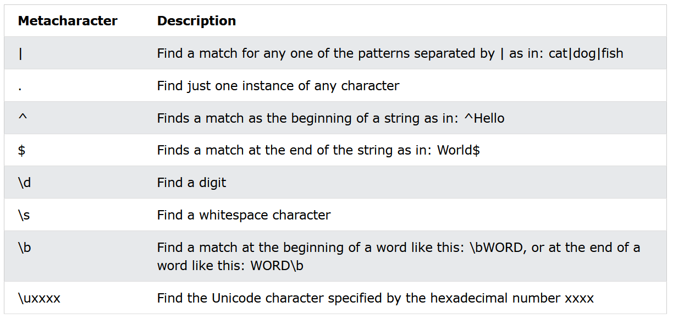
Metacharacters
Metacharacters are characters with a special meaning:

Slide 25
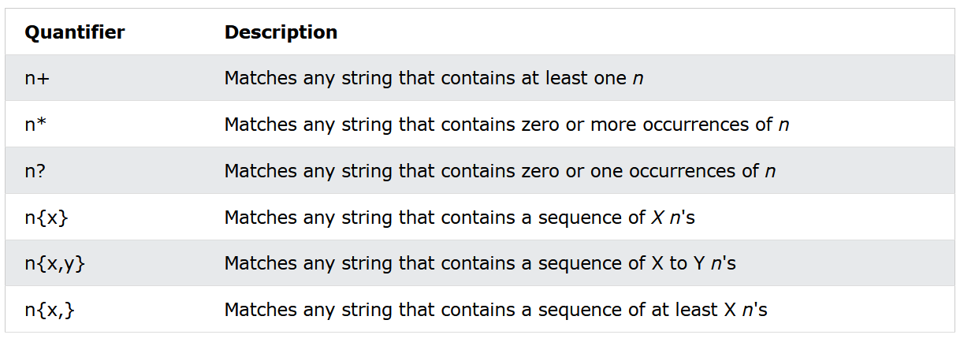
Quantifiers

Slide 26
Grouping
You can use parentheses ( ) to apply quantifiers to entire patterns
Use grouping to search for the word "banana" by looking for ba followed by two instances of na:
<?php
$str = "Apples and bananas.";
$pattern = "/ba(na){2}/i";
echo preg_match($pattern, $str); // Outputs 1
?>

Slide 27
Password regex PHP
Sometimes it is important to check if the user has entered a “strong” password. The regular expression below checks that a password:
Has minimum 8 characters in length. Adjust it by modifying {8,}
At least one uppercase English letter. You can remove this condition by removing (?=.*?[A-Z])
At least one lowercase English letter. You can remove this condition by removing (?=.*?[a-z])
At least one digit. You can remove this condition by removing (?=.*?[0-9])
At least one special character, You can remove this condition by removing (?=.*?[#?!@$%^&*-])
$pattern = "/^(?=.*?[A-Z])(?=.*?[a-z])(?=.*?[0-9])(?=.*?[#?!@$%^&*-]).{8,}$/"

Slide 28
email regex PHP
$pattern = '/^\S+@\S+\.\S+$/'

Slide 29
PHP Form Handling
The PHP superglobals $_GET and $_POST are used to collect form-data.
$_GET
Appends the form data to the URL, in name/value pairs
NEVER use GET to send sensitive data! (the submitted form data is visible in the URL!)
The length of a URL is limited (2048 characters)
Useful for form submissions where a user wants to bookmark the result
GET is good for non-secure data, like query strings in Google

